Slide 1
SMS Spam Detection with Naive Bayes Classification
Eva Diana Maria Conevski

Slide 2
dataset
Kaggle
5572 records
Unsolicited messages (spam): 747
Legitimate messages (ham): 4825

Slide 3
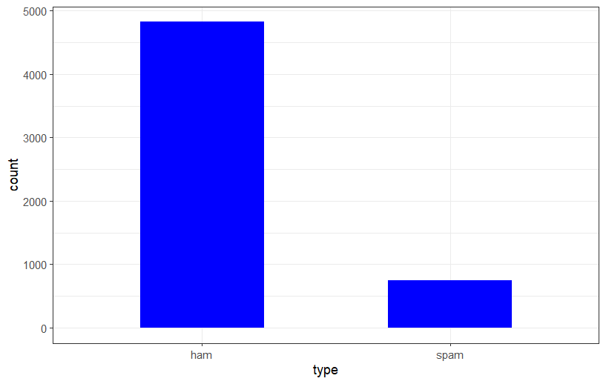
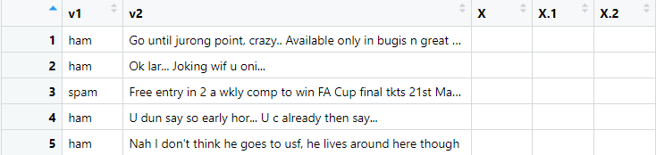
Loading and pre-processing the data

Slide 4
Document-term matrix
A document-term matrix is a mathematical matrix that describes the frequency with which particular terms appear in a particular set
VSource
Pre-processing done:
Turn all words to lower case
Removing numbers
Removing stop words such as: the, a , for, an…
Removing punctuation
Removing various words with the same stem

Slide 5
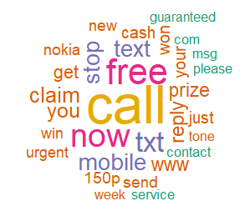
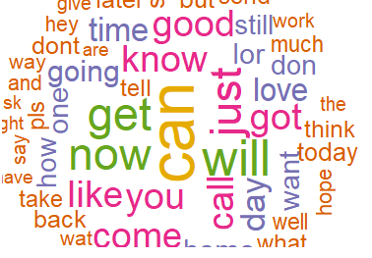
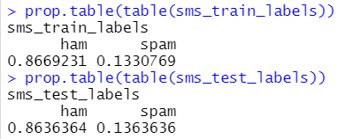
Splitting the data into training and testing set
Training set: 70%
Testing set: 30%
Word-cloud for spam dataset
Word-cloud for ham dataset

Slide 6
Reducing the number of features and converting the input
Reducing the number of features
Converting the numerical input to categorical
From 6118 to 266
sms_freq_words <- findFreqTerms(sms_dtm_train, 30)
convert_counts <- function(x) {
x <- ifelse(x>0, "Yes", "No")
}

Slide 7
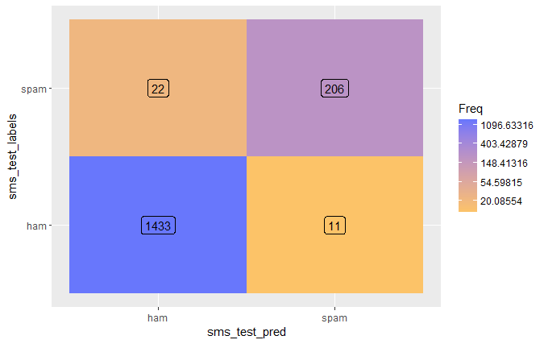
Training the model and evaluating the performance
Accuracy of the model – 98%

Slide 8
Thank you for your attention

